Slide 1
IntegrAGE:
From Vision to Results
TAMARA MRAVINEC

Slide 2










Basic information
Focus: supporting the healthy adaptation and integration of the 55+ workforce into the labour market. The aim is to mitigate the shortage of qualified labour in the regions and to promote a healthy work–life balance.
Duration: 01 / 01 / 24 – 30 / 06 / 26 (5 Periods of 6 months)
Project budget: 2.319.547,18 €
The project involves 15 partners from 10 countries.
Notes:
Zameranie: ....
Obdobie realizácie: 01/2024 – 06/2026
Financovanie: Interreg - program dunajského regiónu).
Nedáme ešte slide na vymenovanie partnerov?

Slide 3
PARTNERS
LEADER - BSC, Business support centre Ltd., Kranj
PROJECT MANAGEMENT- ipcenter.at Ltd.
TREXIMA Bratislava, spol. s r.o.
Associated partners: Slovak Age Management Association and the Federation of Employers’ Associations of the Slovak Republic
J. E. Purkyně University – Ústí nad Labem & Innovation Centre of the Ústí Region
SLAP Association for Creative Development & Business incubator BIOS Osijek
Notes:
Zameranie: ....
Obdobie realizácie: 01/2024 – 06/2026
Financovanie: Interreg - program dunajského regiónu).
Nedáme ešte slide na vymenovanie partnerov?

Slide 4
PARTNERS
Serbian Chamber of Commerce and Industry & Educational Training Centre Serbia
The Human Innovation Group Nonprofit Ltd. & Pannon Novum West-Transdanubian Regional Innovation Non-profit Ltd.
Bulgarian Chamber of Commerce and Industry
Schirrmacher Ltd.
NERDA Development Association
Notes:
Zameranie: ....
Obdobie realizácie: 01/2024 – 06/2026
Financovanie: Interreg - program dunajského regiónu).
Nedáme ešte slide na vymenovanie partnerov?

Slide 5
Relevance of the project
Aging population → impact on society, including labour markets, healthcare systems, and social welfare structures
Global labor landscape is changing → older individuals actively participating in the workforce
Demographic transformation → challenges and opportunities associated with the employment of individuals aged 55 and above
Need of strategies, policies and cooperation projects that foster sustainable employment practices.

Slide 6
General goals of the project
To support the healthy integration of older working generations (55+) into the labour market
To assist them in adapting to the challenges of new ways of working.
To enhance participation of 55+ workforce
To avoid undesired early retirement and extend their productive life in a satisfying way
To strengthen their special skills and competences and to retain their knowledge and accumulated experiences in the economy
To promote knowledge exchange between working generations

Slide 7
An IntegrAGE
System
Cornelia Kramsall
Notes:
Thank you so much, Tamara, and I will continue with our methodology and our approach.

Slide 8
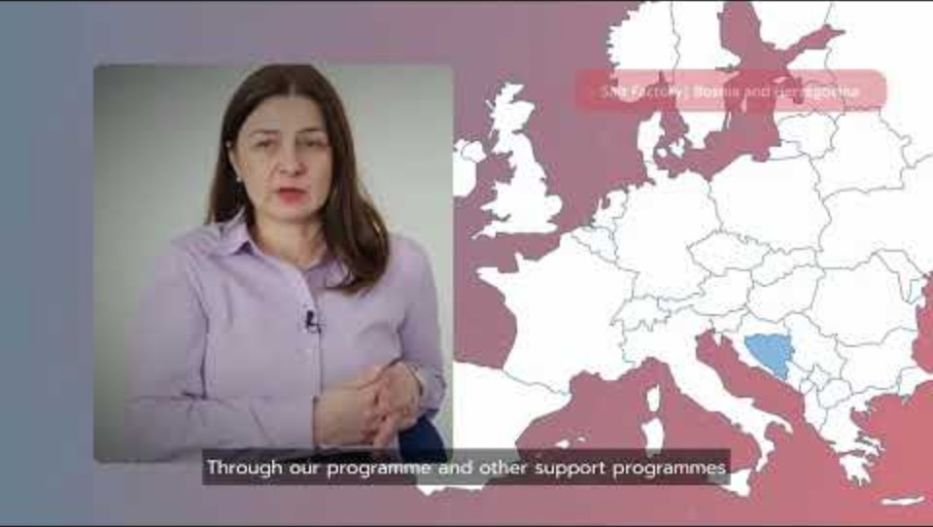
A holistic approach
Notes:
The House of Work Ability (HR model)
Health (foundation)
Skills & competences
Motivation & values
Work environment & leadership
Policy context (external)
👉 Sustainable working lives depend on all levels working together
Speaker note: We built on a well-established HR model – the House of Work Ability. It shows that staying in work is about the balance between health, skills, motivation, workplace conditions and policy frameworks. Importantly: you don’t need to fix everything at once. But this model helps us see what else matters when we start somewhere.

Slide 9
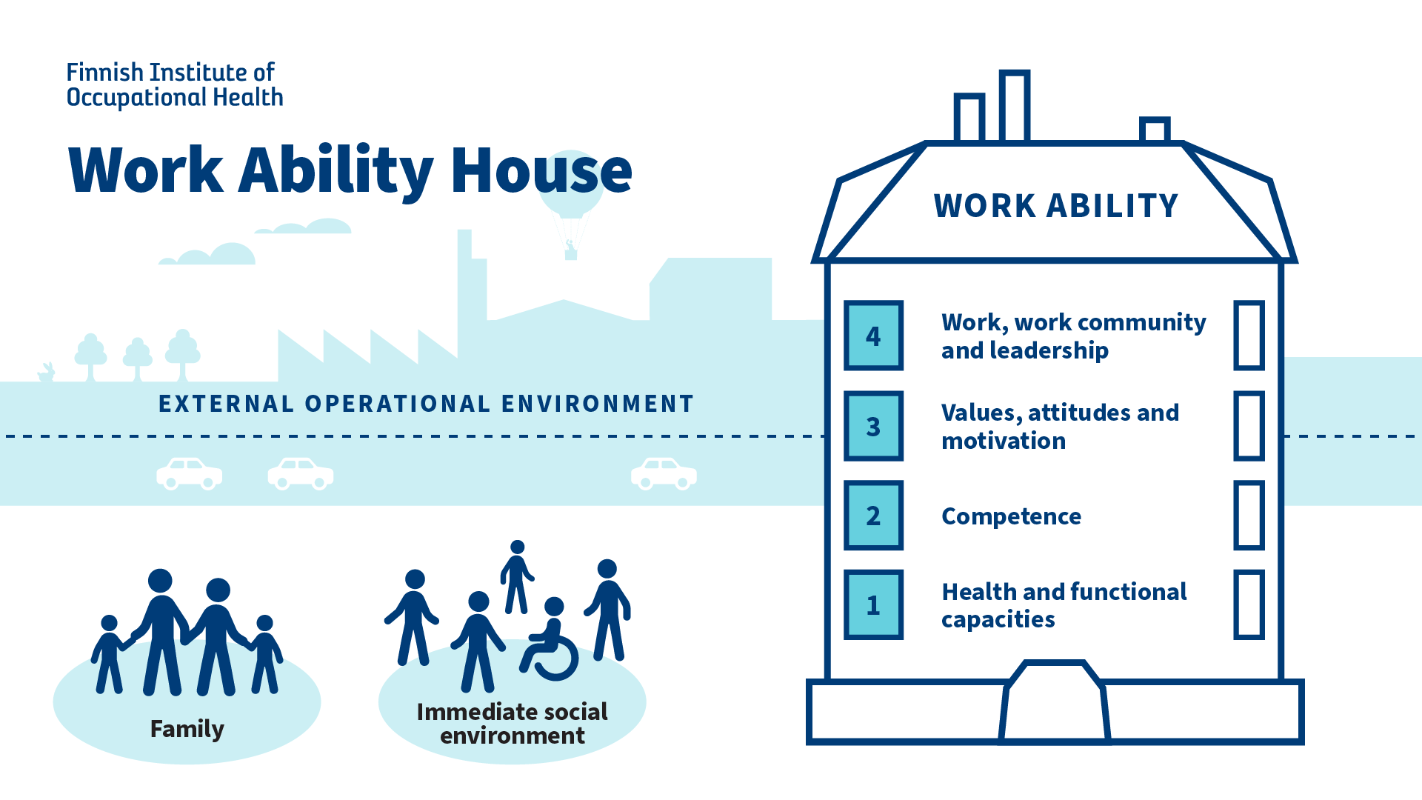
A holistic approach
Notes:
The House of Work Ability (HR model)
Health (foundation)
Skills & competences
Motivation & values
Work environment & leadership
Policy context (external)
👉 Sustainable working lives depend on all levels working together
Speaker note: We built on a well-established HR model – the House of Work Ability. It shows that staying in work is about the balance between health, skills, motivation, workplace conditions and policy frameworks. Importantly: you don’t need to fix everything at once. But this model helps us see what else matters when we start somewhere.

Slide 10
From evidence to practice
Country analyses → identify individual barriers
(10 country analysis based on Interviews with 5 experts each)
Country personas → show real-life situations
(4 country personas)
Policy recommendations → define effective measures (10 national policy roundtables and 10 Business brunches with 10 experts each)
EU good practices → show what works in reality
Notes:
To really understand the situation, we did not rely on just one perspective. We combined several layers of evidence.
The country analyses helped us identify structural barriers and labour market challenges — for example gaps in skills, access to training, or rigid employment structures.
The country personas added an important human dimension. They show how these challenges are actually experienced by individuals — for example difficulties with digital tools, changing motivation, or balancing health and work.
Policy recommendations then translate these findings into concrete measures — showing what governments and institutions see as priorities.
And finally, the EU good practices allow us to test all of this against reality. They show what has actually worked in companies and regions.
Bringing all of this together gives us a much more complete and reliable understanding — not just of the problems, but also of what can realistically be done.

Slide 11

Insights
A consistent picture across Europe
What works in reality
  Structural barriers → limit access to jobs and training
  Skills gaps → especially digital skills reduce opportunities
  Health factors → influence ability to stay in work
  Employer factors → awareness and attitudes matter
  Integrated solutions outperform isolated actions
  Practical, easy-to-use tools are key
  Intergenerational cooperation strengthens workplaces
  Stakeholder collaboration enables success
Notes:
Looking across all countries and sources, we see a very consistent pattern.
Structural barriers include limited access to training, rigid work organisation, or lack of flexible employment options. These make it difficult for older workers to stay in or re-enter the labour market.
Skills gaps — especially digital — are one of the most frequently mentioned challenges. Many 55+ employees have strong experience, but lack opportunities to update their skills in line with changing job requirements.
Health factors also become more relevant with age. This is not only about illness, but also about energy levels, recovery time, and the need for more adaptable working conditions.
And finally, employer-related factors play a major role. Awareness, attitudes, and sometimes stereotypes influence hiring decisions, access to training, and overall inclusion.
At the same time, when we look at good practices, we see what helps to overcome these challenges.
Integrated solutions — meaning combinations of measures — are consistently more effective than isolated actions.
Practical and easy-to-use tools are important, especially for companies, because they lower the barrier to getting started.
Intergenerational cooperation helps transfer knowledge and supports mutual learning.
And stakeholder collaboration — between policy, companies and support organisations — makes implementation more sustainable.
So overall, the message is clear: the challenges are interconnected — and so are the solutions.

Slide 12
The IntegrAGE Strategy for the Danube Region
Employment & Labour Market Integration
Health & Wellbeing
Training & Lifelong Learning
Flexible Employment & Workplace Culture
Entrepreneurship & Innovation
promoting inclusive employment practices and reducing age-related barriers.
integrating physical and mental wellbeing into age management strategies
supports employability and skills adaptation across the life course
flexible employment models and supportive organisational practices
valuing experience and fostering cross-generational collaboration.

Slide 13

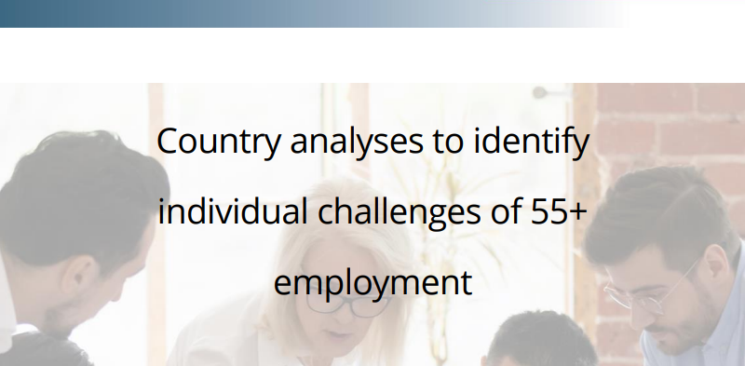
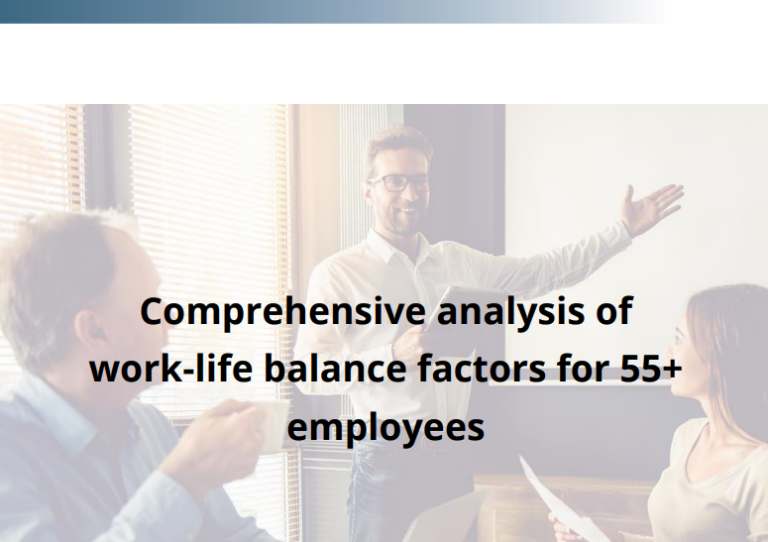
Analyses
Country analyses to identify
individual challenges of 55+
employment
Comprehensive analysis of
work-life balance factors for 55+
employees

Slide 14
A holistic approach
IntegrAGE
3 Pillars
Policy level
Company level
Employee level
Framework, incentives, inclusion
HR practies, flexibility, age management
Health, skills, motivation
Notes:
👉 Start anywhere — but connect over time
Speaker note: The key is not to do everything immediately. Many organisations or regions start with one entry point — for example training or flexible work. That is good. What matters is to gradually connect these efforts across levels.

Slide 15
Why isolated measures have limited impact
Single measures are useful
… But often not enough on their own
Examples:
Training helps, but needs supportive workplaces
Health measures help, but need flexibility at work
Policies help, but need employer uptake
Notes:
👉 Impact increases when measures are connected
Speaker note (with explanation): This is important: we are not saying single measures are wrong. They are often the first step. But their impact stays limited if they are not connected to other elements. That is why alignment matters.
Speaker note (with evidence): Good practices across Europe show that success often starts small. But the most effective approaches gradually combine measures — linking skills, wellbeing and workplace changes. This leads to better retention, motivation and performance.

Slide 16
Tools overview
Supporting 55+ employees is a system
  Individuals
  (Skills training for employees, Tandem mentoring programmes)
  Workplaces
  (AM Trainings and Tools for HR, AM Platform, Quality Seal for Companies in AM, agemanagementplatform.com)
  Policies
  (Strategy and Action plans)
Start somewhere | connect over time
Notes:
Speaker note: The key takeaway is: you don’t need a perfect system from day one. But understanding that it is a system helps to build better solutions over time. And this is where the IntegrAGE approach supports the next steps.

Slide 17
IntegrAGE in Practice:
Tools & Solutions
Pavol Hudec

Slide 18

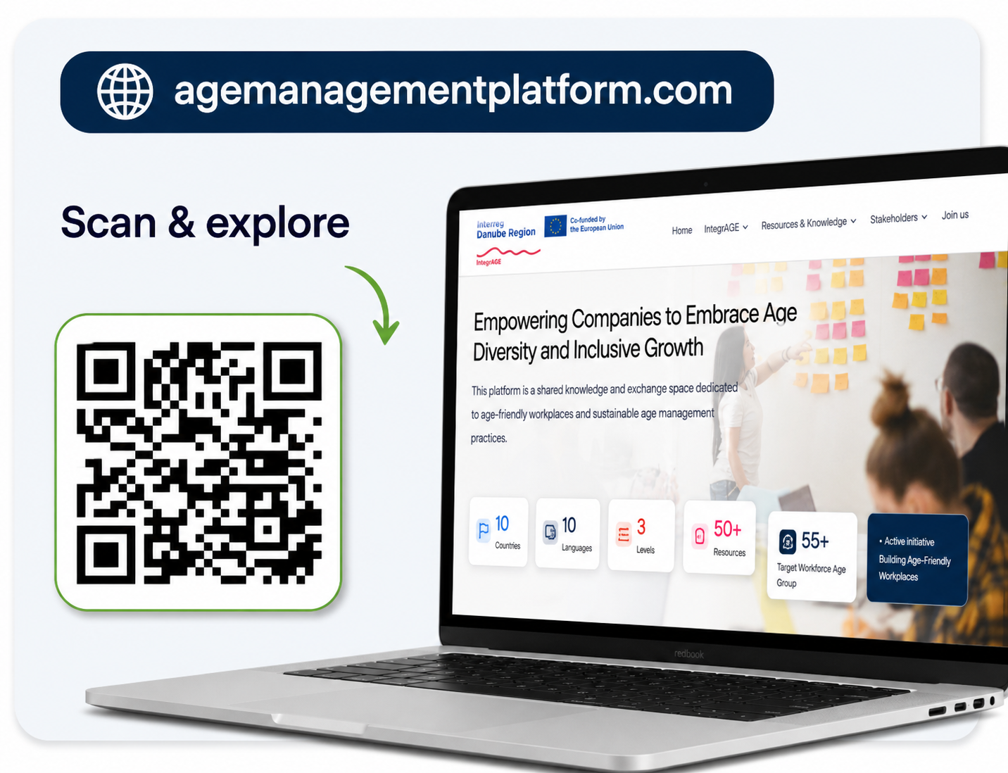
Age Management Platform
Main idea:
One entry point to IntegrAGE practical tools, training materials, good practices, and information for policymakers, employers, HR professionals, and employees.

Slide 19
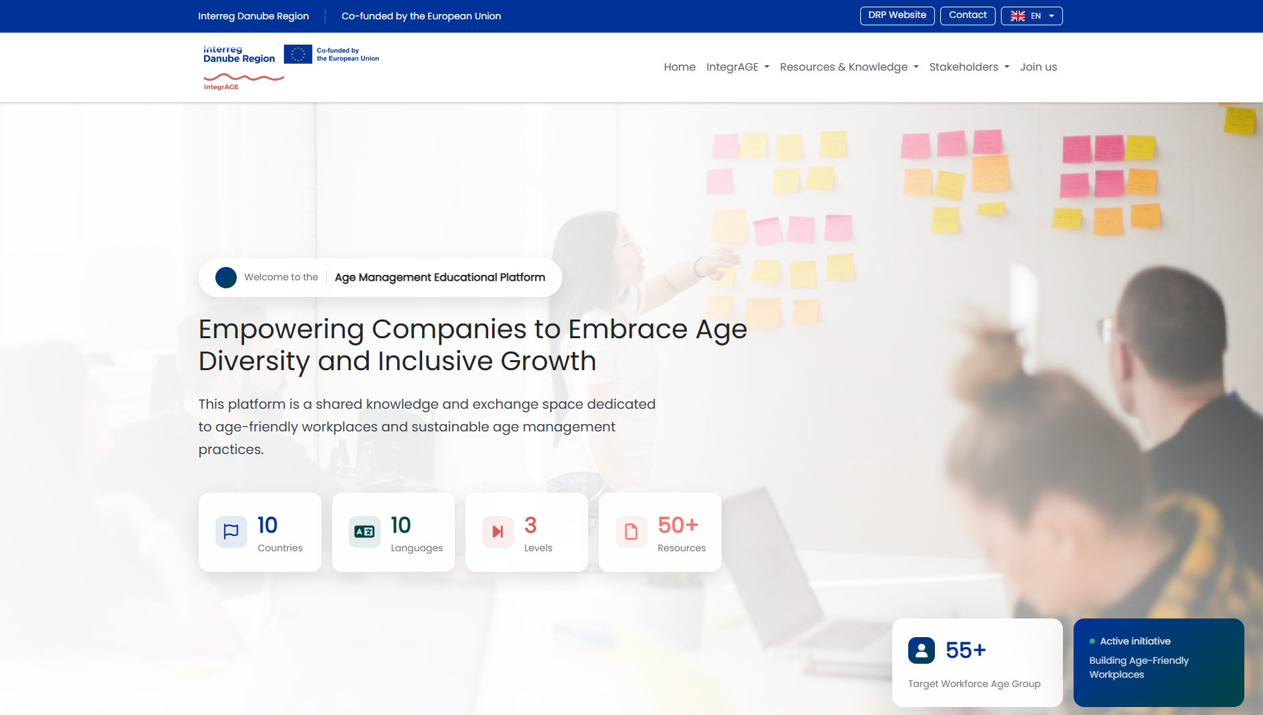
HOMEPAGE

Slide 20
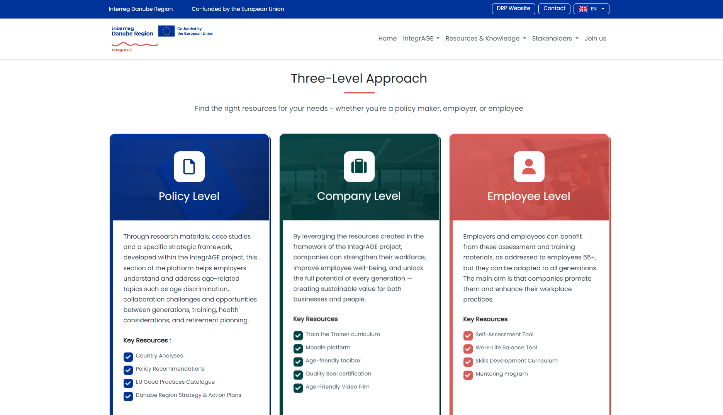

Slide 21
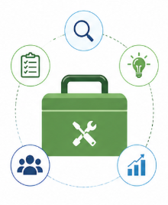
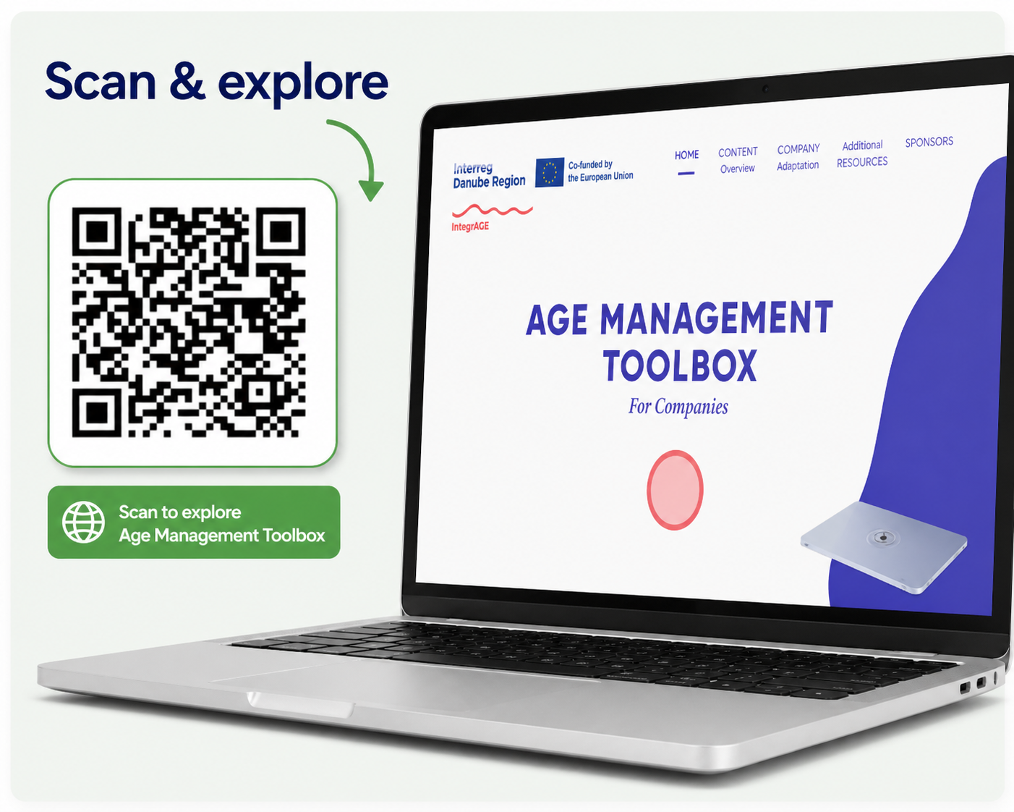
Age Management Toolbox
Main idea:
A set of practical tools that help companies assess needs, choose solutions and implement age-friendly practices in everyday work.

Slide 22
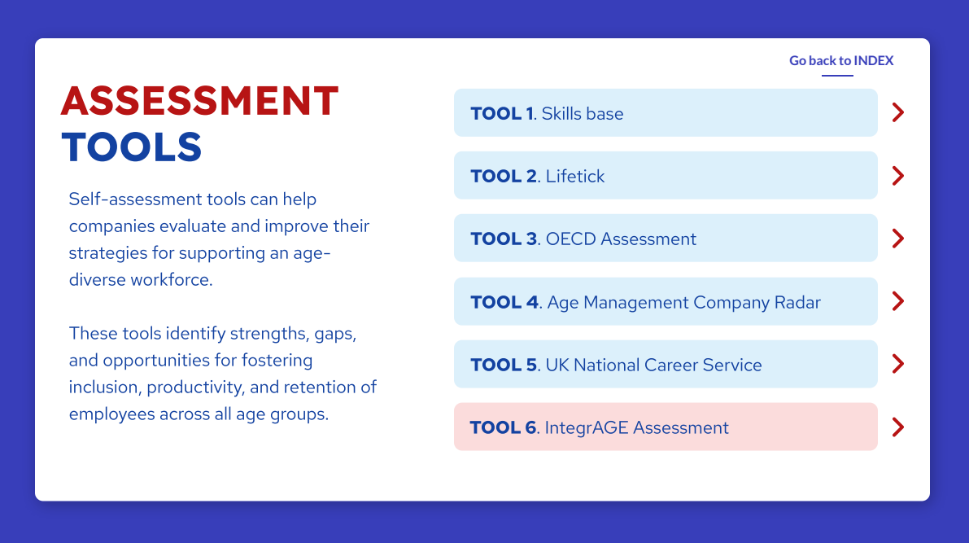

Slide 23
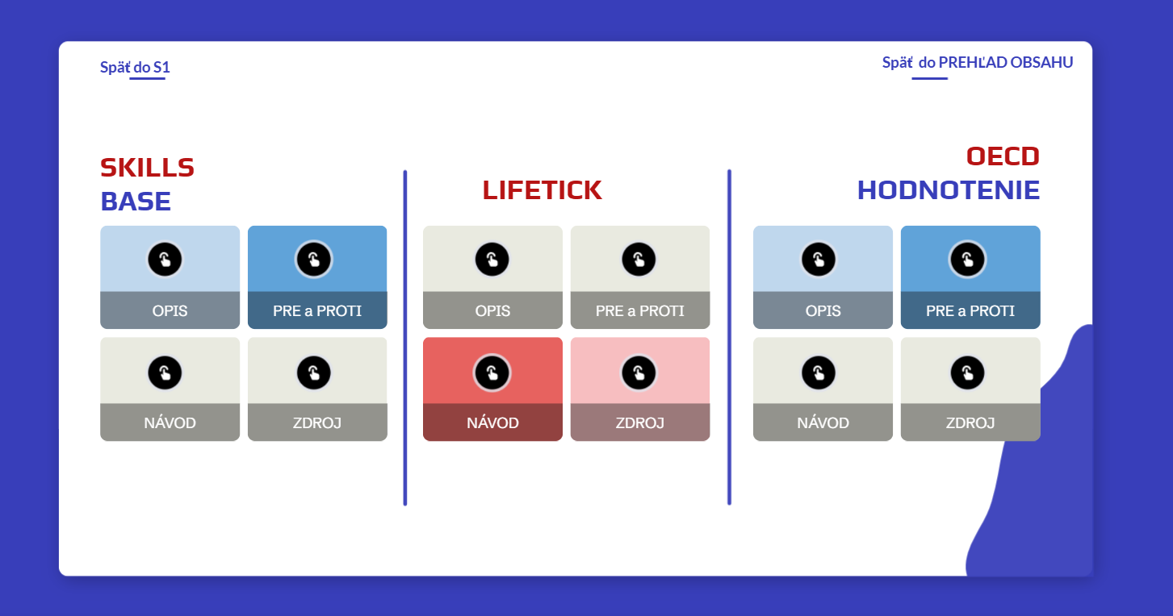

Slide 24
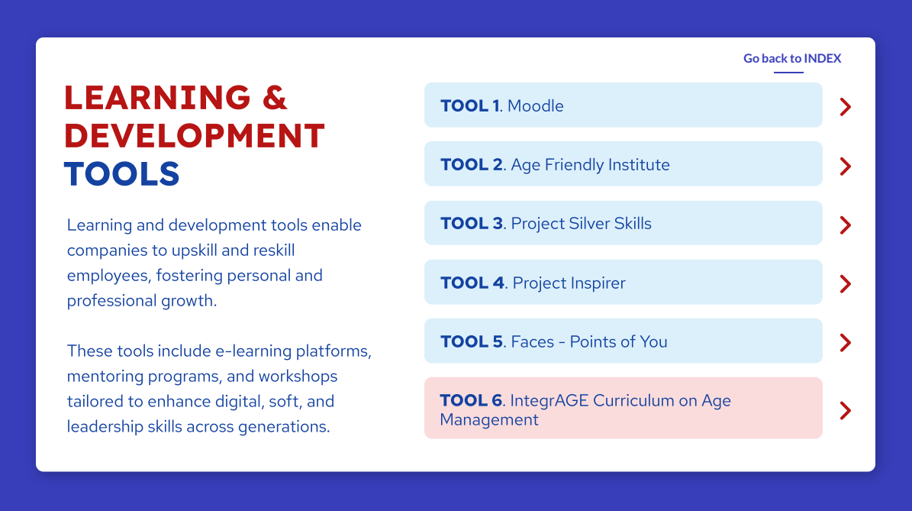

Slide 25
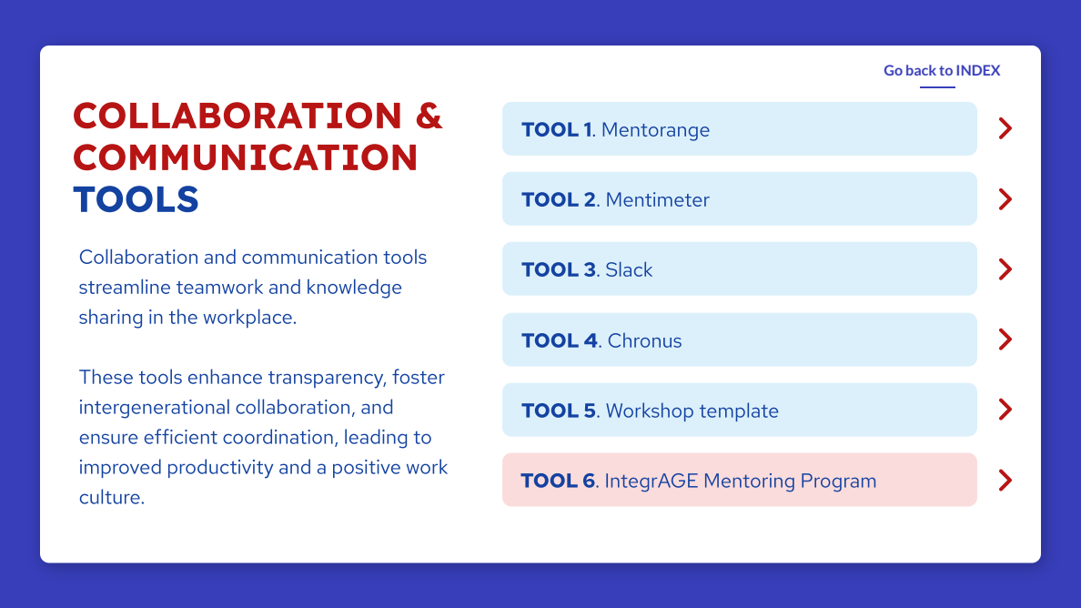

Slide 26
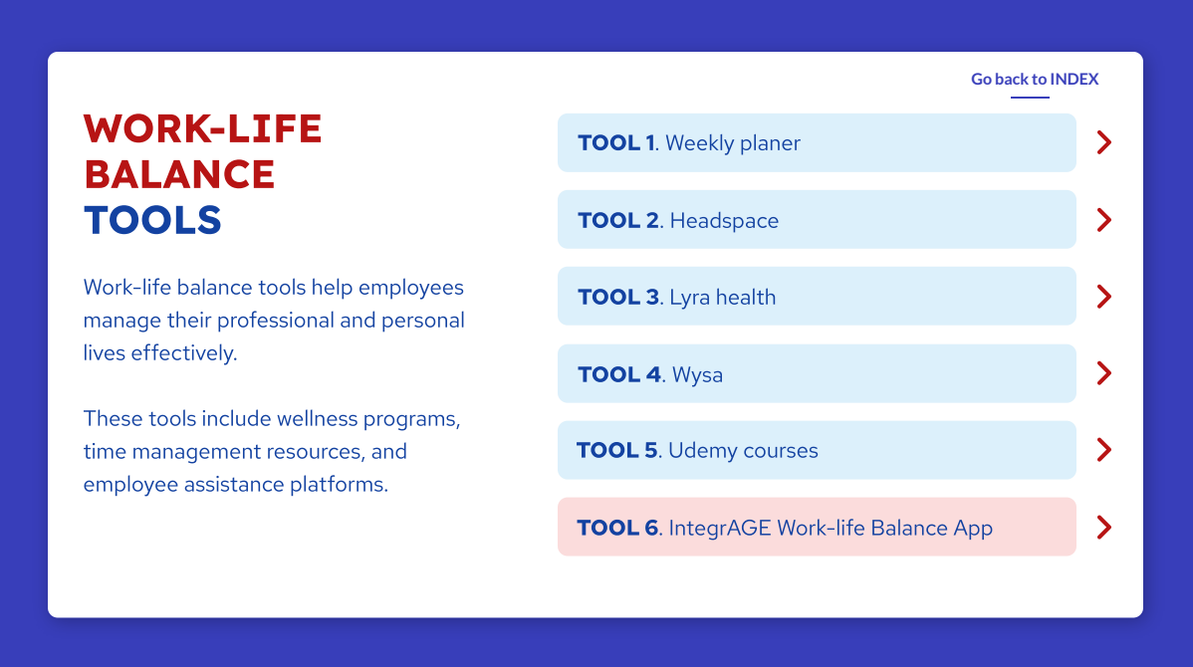

Slide 27
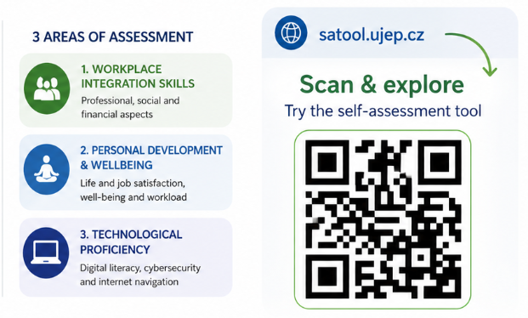

Self-assessment tool
Main idea:
A self-assessment tool to identify your strengths and discover areas for improvement.

Slide 28
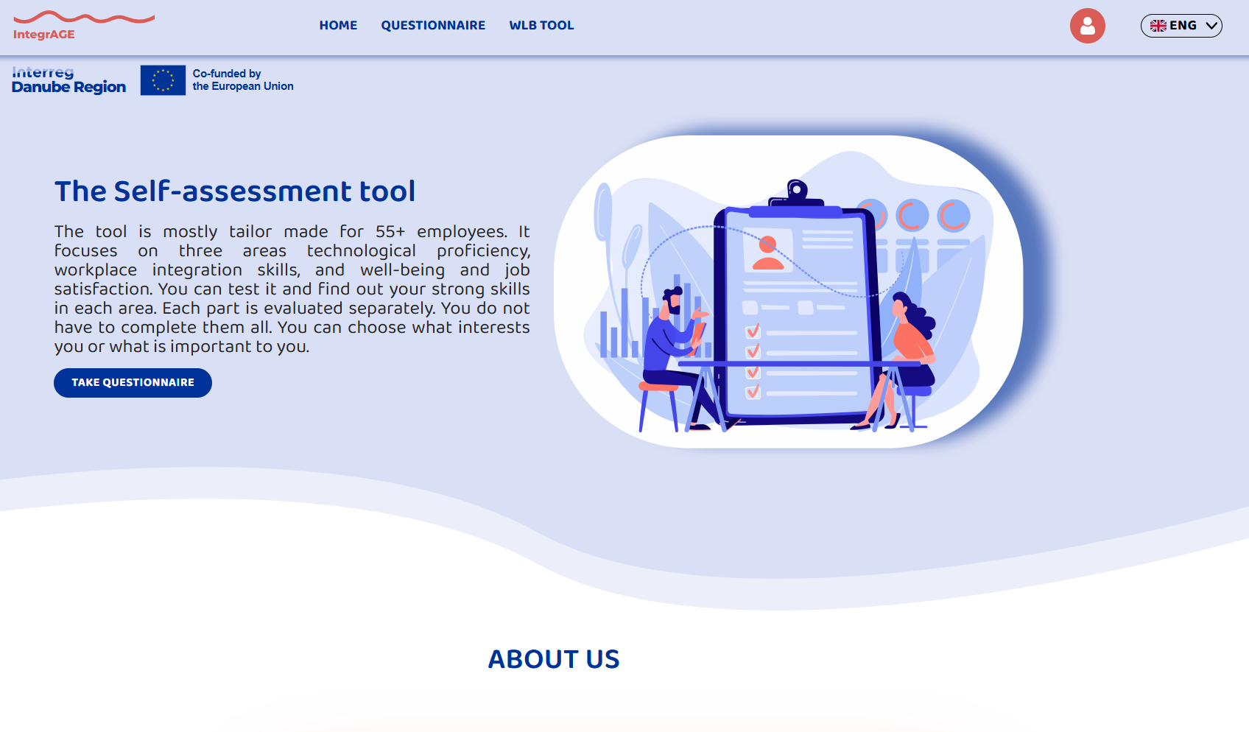

Slide 29
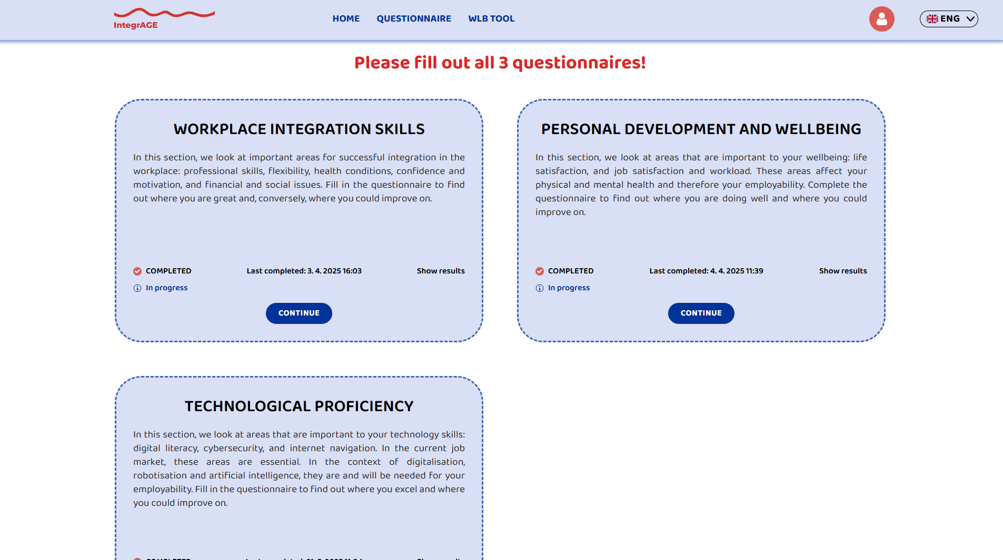

Slide 30
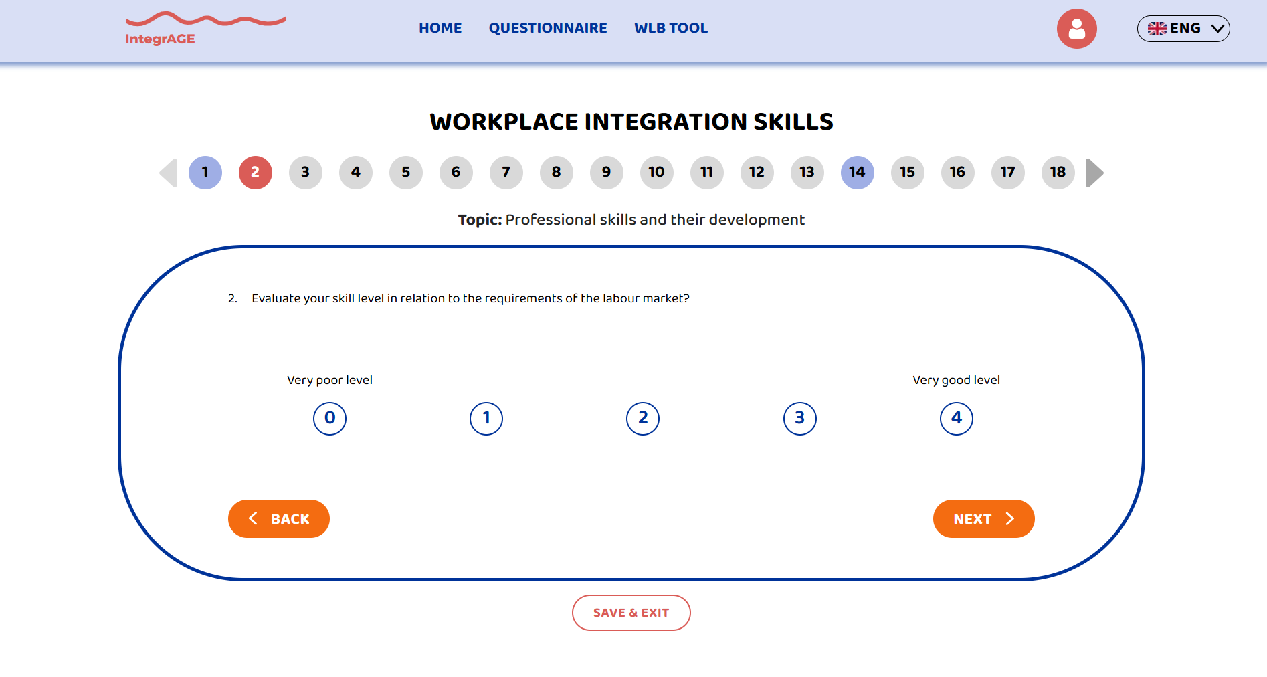

Slide 31
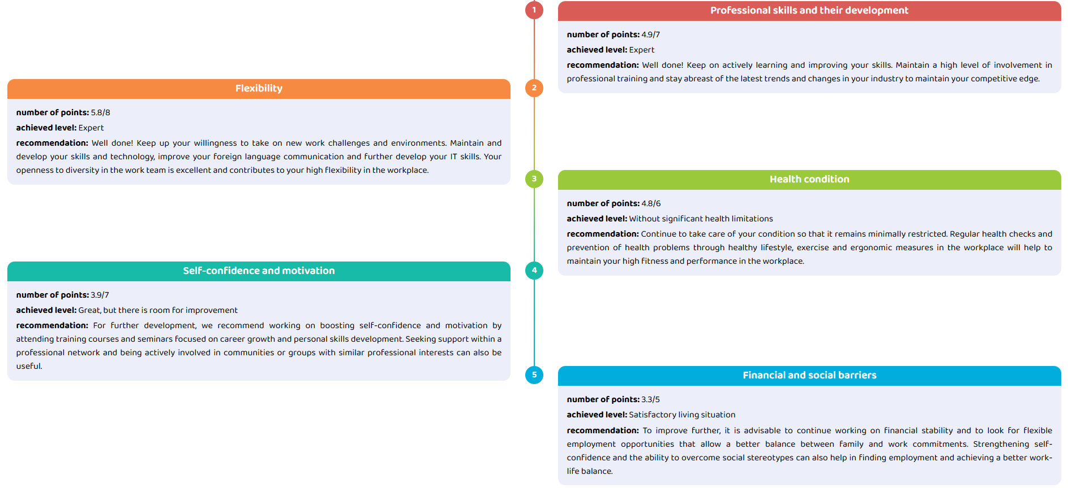

Slide 32
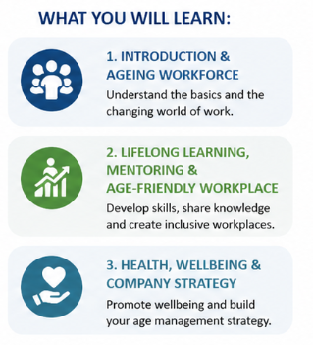

Learning platform (Moodle)
7 modules for age-friendly workplaces
Main idea:
A complete learning journey combining theory, practice and interactive tools to support age management in companies.

Slide 33
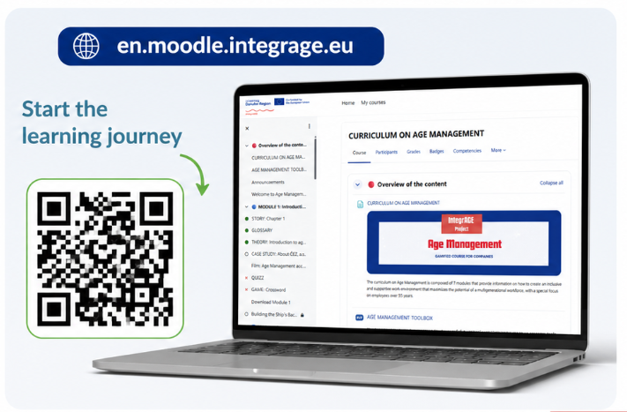
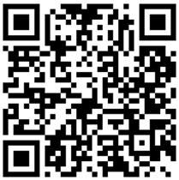
Learning platform (Moodle)
7 modules for age-friendly workplaces
Interactive learning format:
📖 Theory & stories
🏢 Case studies (Google, IBM, Dell…)
🎥 Videos
🧠 Quizzes & games
📥 Downloadable materials

Slide 34
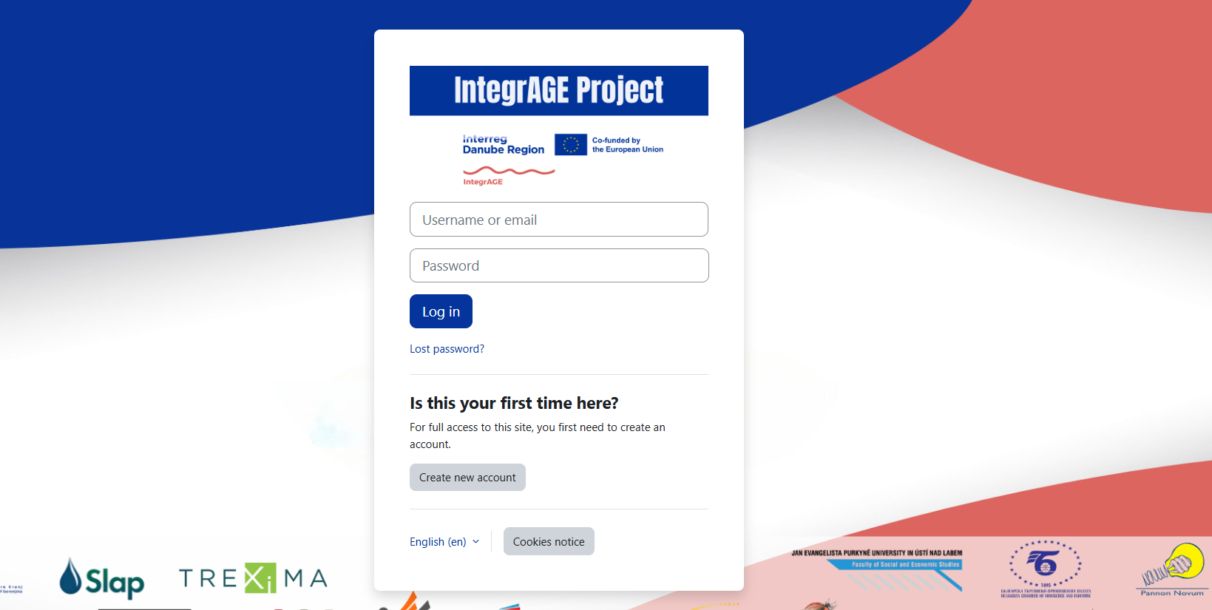

Slide 35
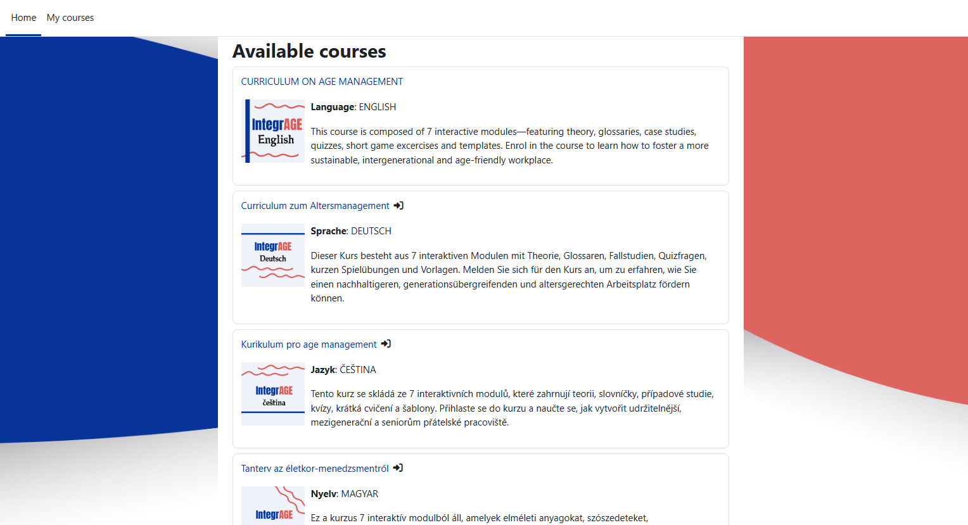

Slide 36
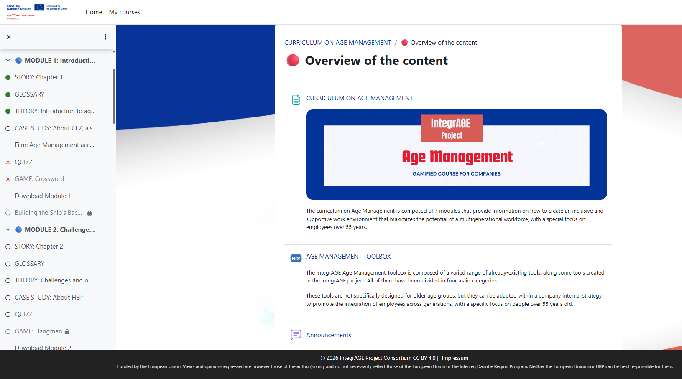

Slide 37
Age-friendly Quality Seal
🧠
Main idea:
A structured self-assessment helping organizations identify gaps and improve age-friendly practices across key areas.
5 areas of assessment:
👥 Hiring practices
🪑 Workplace ergonomics
📚 Learning & development
⚖️ Anti-ageism policies
❤️ Health & wellbeing

Slide 38
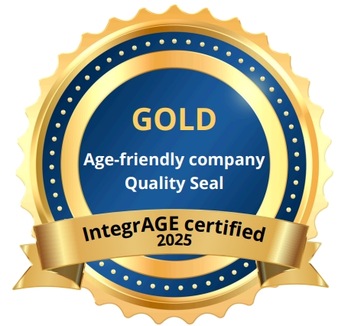
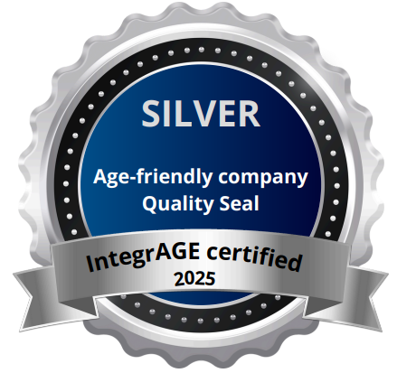
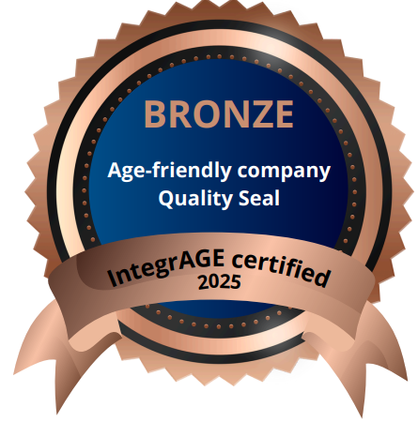
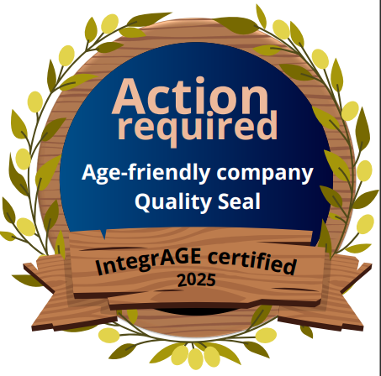
Age-friendly Quality Seal
Scoring (1–10):
identifies strengths & weaknesses
🥇 Gold (8.6 – 10)
🥈 Silver (7.0 – 8.5)
🥉 Bronze (5.0 – 6.9)
⚠️ Action required (< 5)

Slide 39
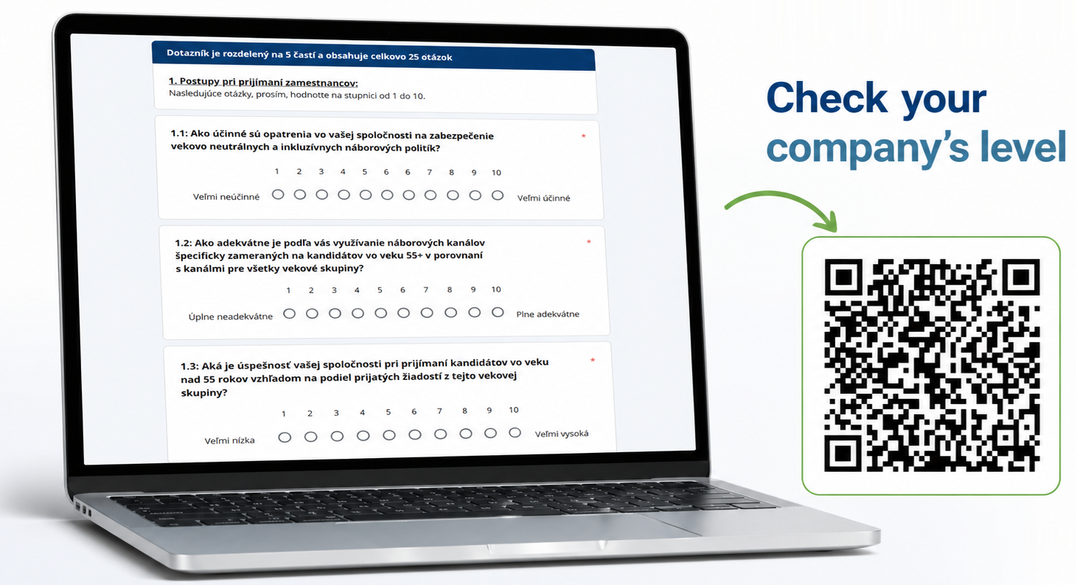
Age-friendly Quality Seal
⚠️ If results are low:
identify gaps in company practices
define improvement actions
implement changes step by step
monitor progress

Slide 40
Piloting of IntegrAGE tools in practice
⚙️
Main idea:
We tested IntegrAGE training and tools in real company environments across 6 countries.
🧩 What we tested
💻 Moodle platform
Modules 1 – 4 → usability & learning experience
Modules 5 – 7 + Quality Seal → advanced content & certification
🧰 Age Management Toolbox
📅 Period: Sep – Dec 2025
👥 Participants: 92

Slide 41
Train the Trainer programme
🧠
👥 1. Understanding older workers
Needs, motivations and challenges of 55+ employees
⚖️ 2. Combating ageism
Building inclusive and age-friendly workplaces
❤️ 3. Health & wellbeing
Supporting physical and mental health at work
🔄 4. Mentoring & reverse mentoring
Knowledge sharing across generations
💻 5. Digital inclusion & lifelong learning
Technology training and continuous development
🏢 6. Age-friendly workplace practices & retirement
Work organisation and gradual retirement strategies
Main idea:
A practical training programme equipping trainers and HR professionals with skills to support 55+ employees and create age-friendly workplaces.

Slide 42
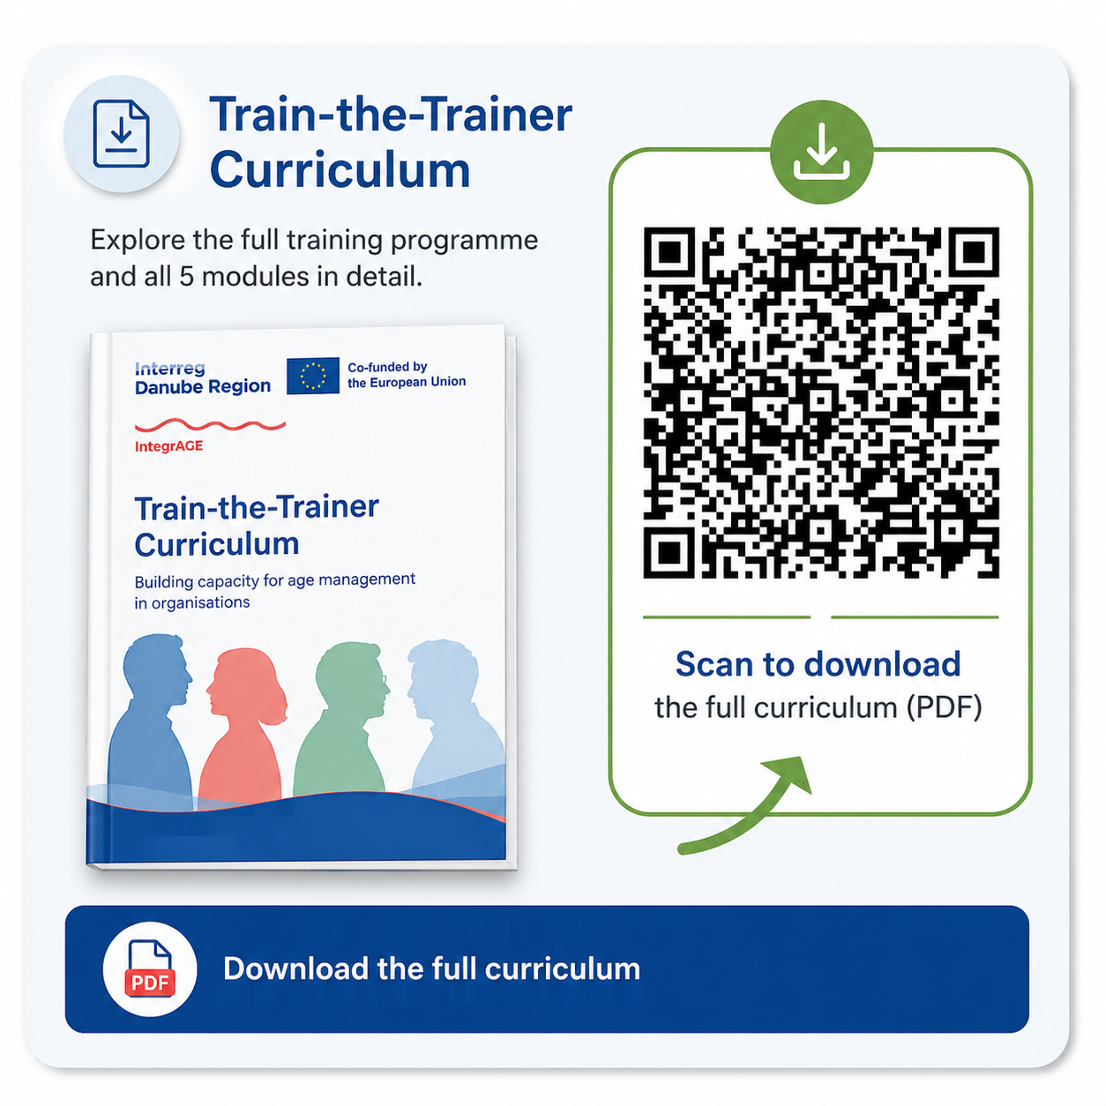
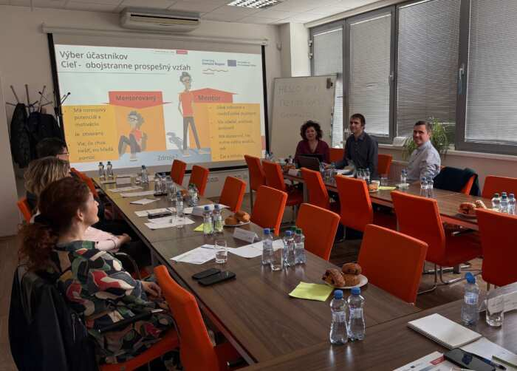
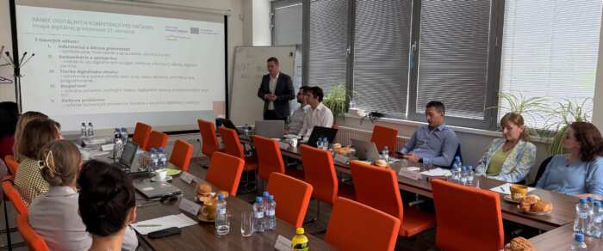
Train the Trainer programme

Slide 43
Curriculum on the challenges of the new way of working
🧠
Main idea:
We delivered practical trainings focused on developing key skills of employees, with emphasis on digital, communication and wellbeing competencies.
🤝 1. Digital communication & AI
Tools for communication, collaboration and task management, practical use of artificial intelligence
🔒 2. Cybersecurity & problem solving
Recognising risks, protecting data, solving common technical issues
💼 3. Labour market & financial skills
Digital tools for job search, career planning and financial safety
🗣️ 4. Confidence & communication
Self-confidence, communication skills, presenting your strengths
🌱 5. Stress management & leadership
Managing stress and resilience, developing leadership skills

Slide 44
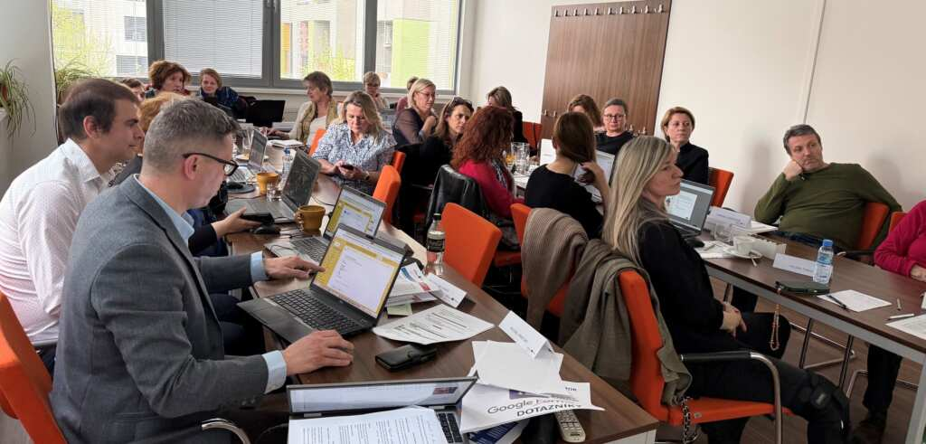
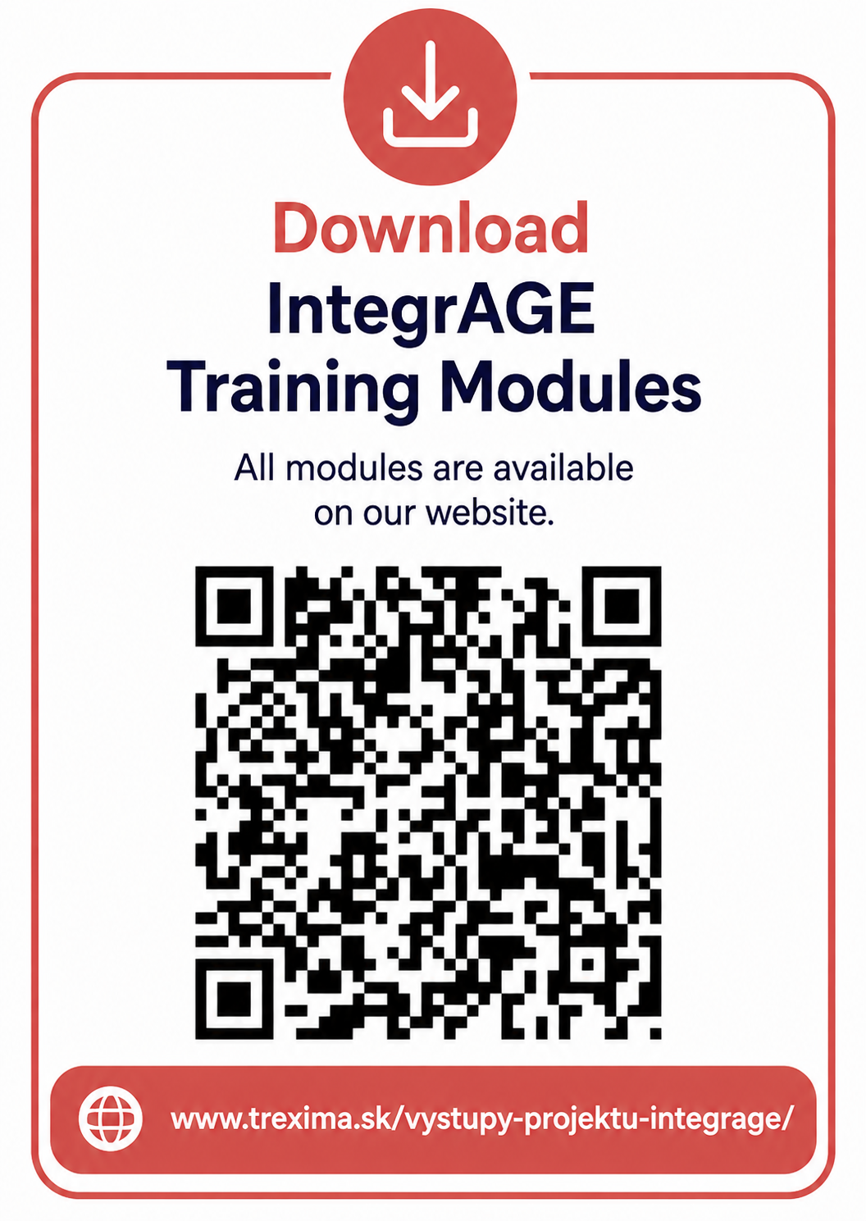
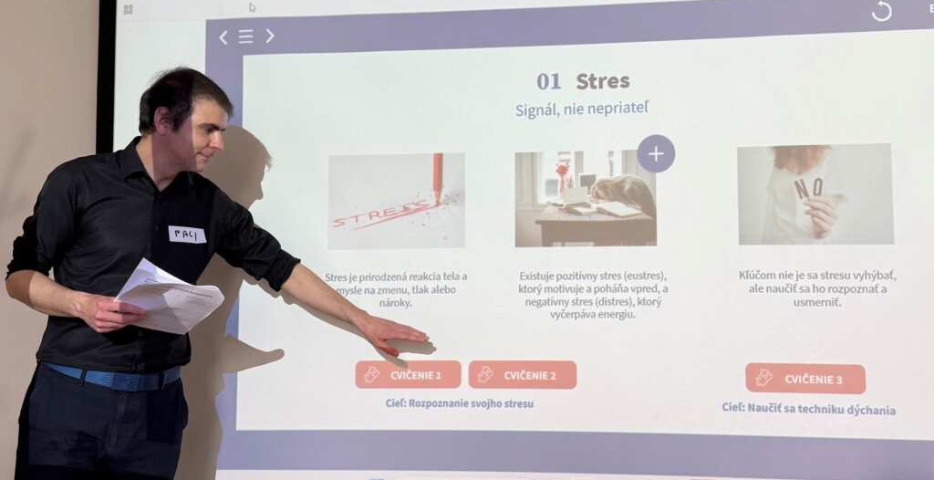
Curriculum on the challenges of the new way of working

Slide 45
Living Learning Labs
Intergenerational mentoring in real working environments
🌍 Implemented across 6 countries:
⚙️ How it works
Select companies (1-2 per country)
Train 5-6 mentors (3 workshops)
Involving 5-6 young employees (mentees)
Implement mentoring (3 months, 8–12 sessions)
Monitor & evaluate
Create handbook

Slide 46
Thank you for your attention 😊

